Slide 1


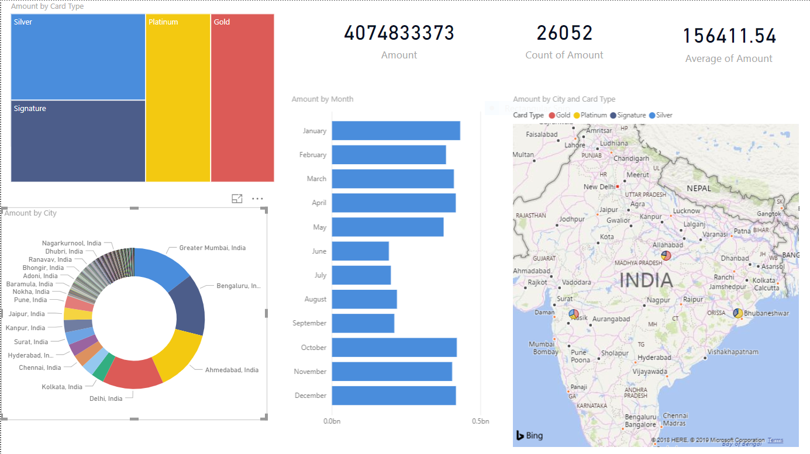
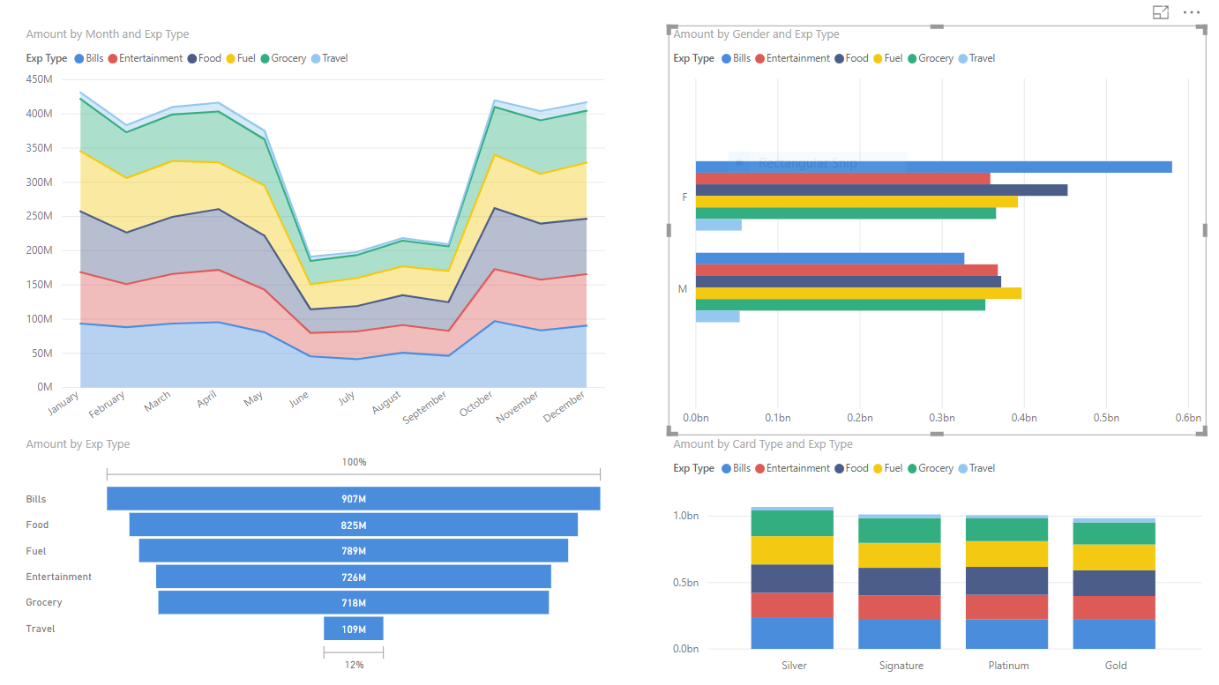
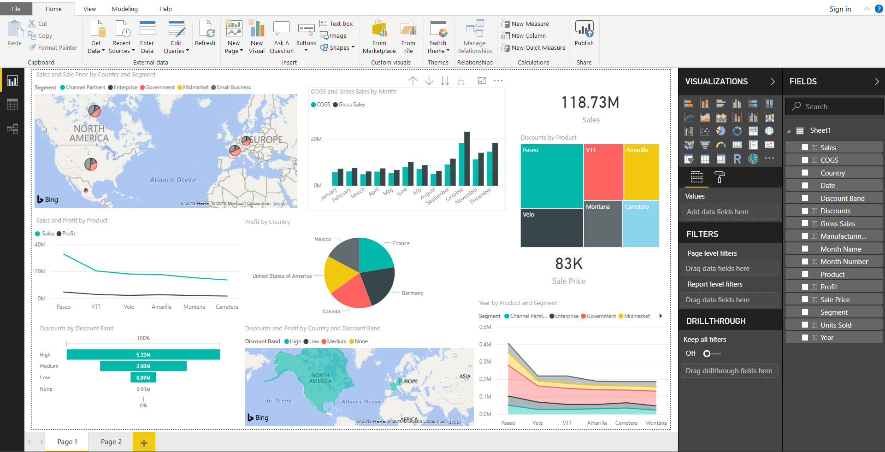
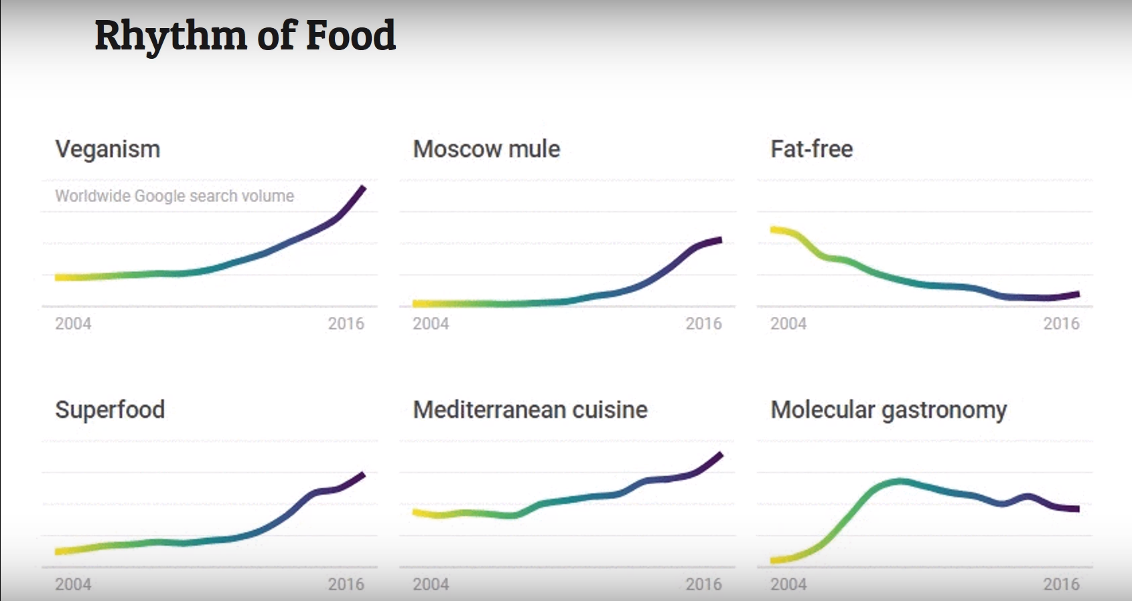
Data Analysis And Visualization Using Power BI
SREE VIDYANIKETHAN ENGINEERING COLLEGE
KOLLI CHANDANA MANDALA HEPSIBAH
FACUILTY CO-ORDINATOR: Mr. M. THRILOK REDDY
Visualization and Analysis
Credit Card Transactions in India
Why Power BI?
Data visualization depends on the effectiveness of the data, or how the data is used to come up with conclusions.
Data analytics deals with data at a much deeper level compared to visualization.
Self-service Business Intelligence.
Accessible to end user without IT involvement.
Machine Learning features.
Mobility (Mobile, Desktop components, Dashboards ).
Lower upfront costs.
API ‘s for integration.(Application Protocol Interface).
Customization.
User friendly.
Advanced Analytics.
Cortona Integration.
Business Intelligence
Business intelligence(BI) represents the tools and systems that play a key role in the strategic planning process within a corporation.
Sisense, Looker, Yellowfin, Tableau, SAP Crystal Reports, Domo, Microsoft Power BI are some best business intelligence tools for small and big businesses.
Fig.2: Report 1 on credit card transactions
The Future of Data Visualization
Power BI
The vast majority of data visualizations today are two-dimensional. However, that’s changing with creative use of color and size, combination of space and time, and advanced computer graphics.
Data visualization will be automated soon; some of it is done so already. ... Of course, some parts of data visualization are tremendously aided by some parts of automation.
A Business Intelligence cloud service by Microsoft.
Access data from hundreds of supported on-premises such as Dynamics 365, Salesforce, Azure SQL DB, Excel, and SharePoint.
A power BI dashboard is a single page, often called a canvas, that uses visualization to tell a story.
Fig.3: Report 2 on credit card transactions
Credit card transactions in India were made with different card types.
States like Mumbai, Bangalore, Ahmadabad and Delhi do more credit card transactions compared to other states in India.
Most of the credit cards are used to bills payments.
Very less payments are made for travelling.
Females do pay more bills with credit cards compared to males.
Fig.1: Power BI Desktop
Fig.4: Rhythm of food

